Slide 1


DRN: A Deep Reinforcement Learning Framework for News Recommendation
Guanjie Zheng, Fuzheng Zhang, Zihan Zheng, Yang Xiang,
Nicholas Jing Yuan, Xing Xie, Zhenhui (Jessie) Li

Slide 2
Introduction: Why reinforcement recommendation
Second round
First round
Equal rewarding recommendation for current round
Images from:
https://www.ohio.com/akron/sports/cavs/cavaliers-j-r-smith-expects-lebron-james-to-keep-opening-night-streak-alive-despite-sprained-ankle
https://www.cnbc.com/2018/03/05/kobe-bryant-has-won-an-oscar-heres-what-he-says-it-takes-to-succeed.html
https://twitter.com/NBA
https://www.stgeorgeutah.com/news/archive/2016/06/11/djg-alert-significant-weather-strong-thunderstorm-rolls-through-washington-county/#.WsqHUdPwb6Y
http://www.clipartpanda.com/clipart_images/question-mark-36565633
Notes:
The first question, why reinforcement recommendation?
In the context of news recommendation, …
Suppose you are given two articles, one is, one is. You have the same willing to read about these two articles.
However, if we look one more step forward, for the weather one, it is really hard for us to make further infer about what you want to read. But if you click on the kobe Bryant, it is very possibly safe to recommend you more articles about basketball.

Slide 3
Introduction: News recommendation is dynamic
The life period for news is usually very short.
User’s interest may change during time.
Notes:
The average life span for a news is usually several hours.
During the first few weeks, this user prefers to read
about “Politics”, but his interest gradually
moves to “Entertainment” and “Technology” over time.

Slide 4
Introduction: Is there more than click/no-click?
User’s clicks on news are usually very dense in a short period. Then, user usually leave the app!
User may return everyday!
Notes:
Another question, will there be more information rather than just click / no click to describe the long term effect of one recommendation?

Slide 5
Introduction: Should we keep recommending similar items?
Lebron James will be the MVP!
Tony Parker has come back from injury!
Paul Gasol promises to help the Spurs in the playoff.
Will you get bored if all the recommended news are from NBA when you are browsing the sports news?
Images from:
https://twitter.com/nba

Slide 6
Method: Using reinforcement learning to do recommendation
Notes:
State: user features
Action: news features
Reward: click label + user activeness

Slide 8
Method: Dueling network structure – value and advantage function
Notes:
V(s) value function: whether user will read depends on the user’s behavior and context
A(s,a) advantage function: whether user will read depends on how well the news matches the user’s interest

Slide 9
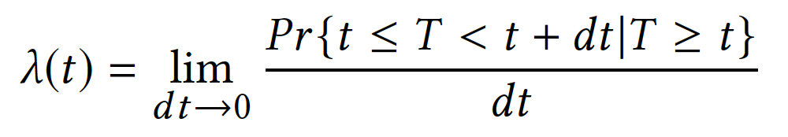
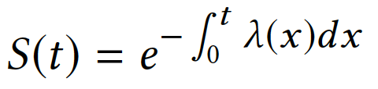
Method: user activeness modeling -- survival analysis
User activeness decay function
User activeness
Notes:
Hazard function: instantaneous rate at which events occur
Survival function: user activeness survivals

Slide 10
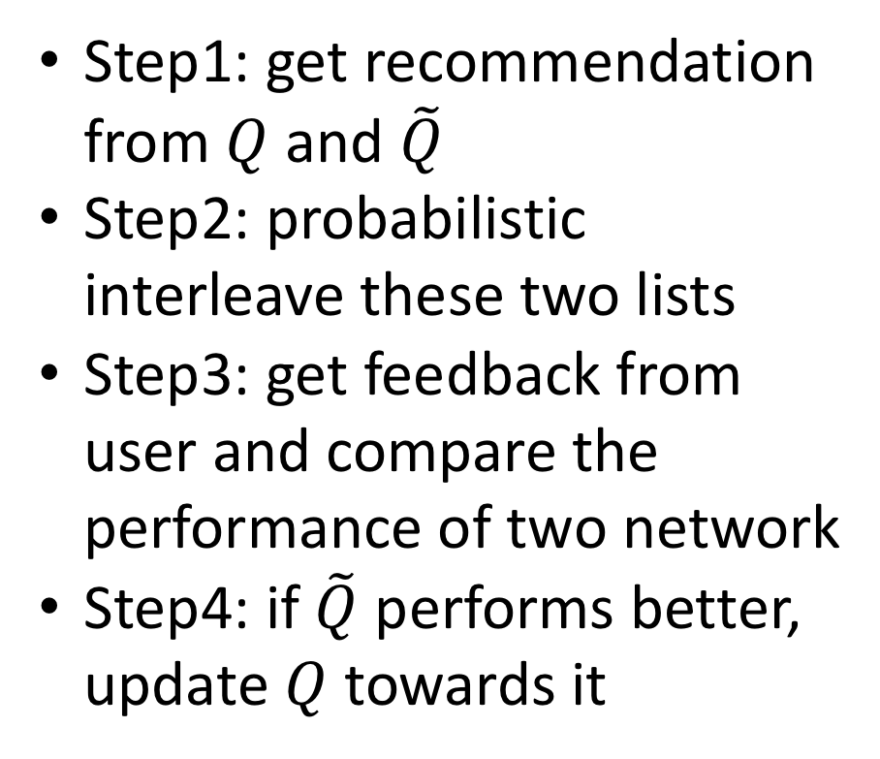
Method: Effective exploration
Step1: get recommendation from $Q$ and $\tilde{Q}$
Step2: probabilistic interleave these two lists
Step3: get feedback from user and compare the performance of two network
Step4: if $\tilde{Q}$ performs better, update $Q$ towards it
Notes:
How to do effective explore?
Random exploration? Harm the user experience in short term.
Multi arm Bandit: variance? Same issue, and long time to converge

Slide 11
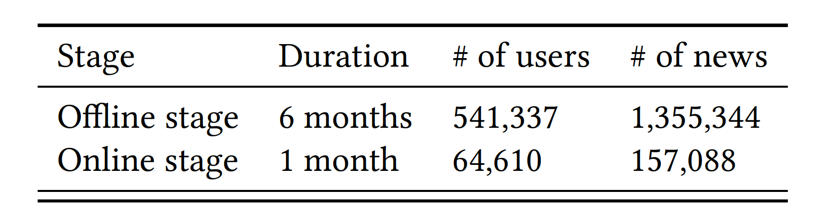
Dataset

Slide 12
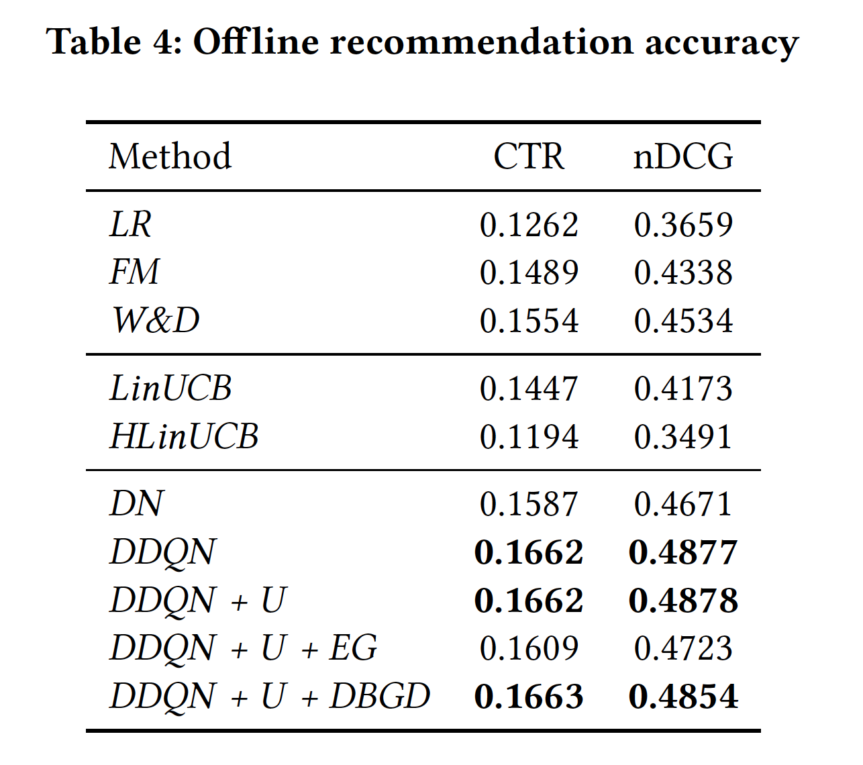
Results: Offline
Accuracy

Slide 13
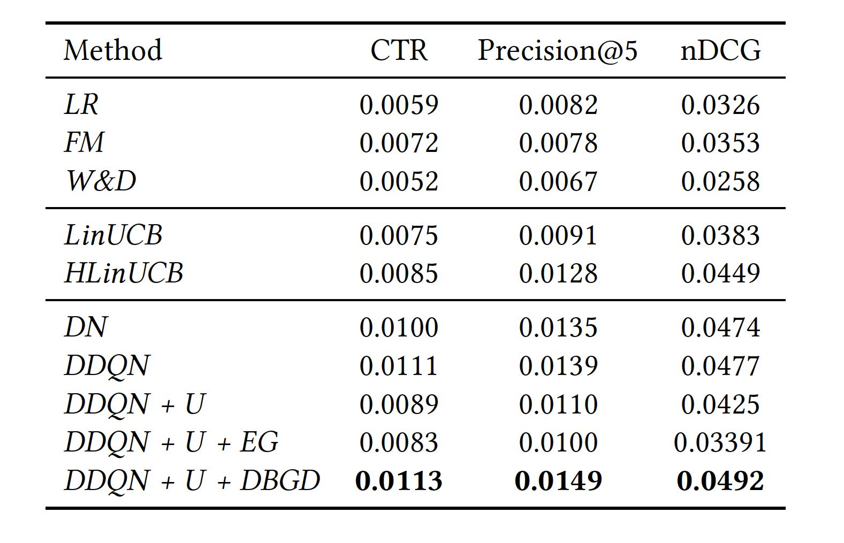
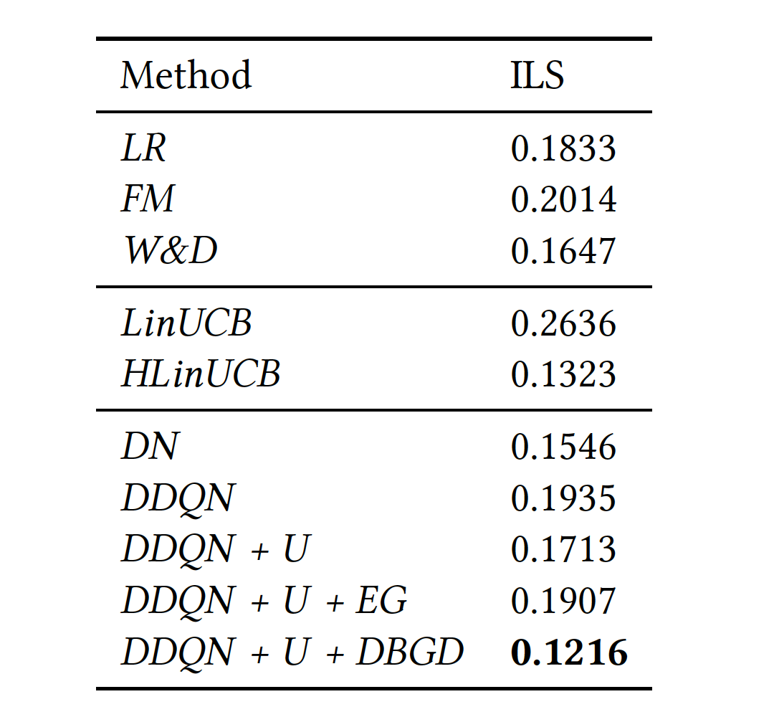
Results: Online
Accuracy
Diversity
Notes:
ILS: intra-list similarity

Slide 14
Summary of motivation and solution
Motivation | Solution
Long term effect in recommendation | Deep reinforcement learning (DRL)
Dynamic nature of news recommendation Consider more measures for long term effect Recommendation diversity | Online learning feature of DRL Reward function design of DRL Explore in DRL

Slide 15
Conclusion
We propose a reinforcement learning framework to do online personalized news recommendation, taking care of both immediate and future reward. Our framework can be generalized to many other recommendation problems.
We consider user activeness to help improve recommendation accuracy, which can provide extra information than simply using user click labels.
Our system has been deployed online in a commercial news recommendation application. Extensive offline and online experiments have shown the superior performance of our methods.

Slide 16
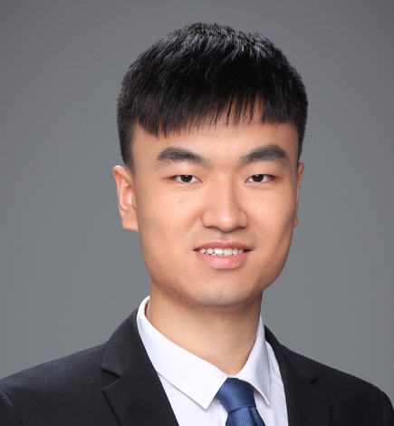
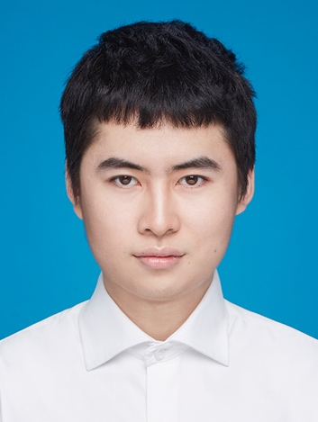
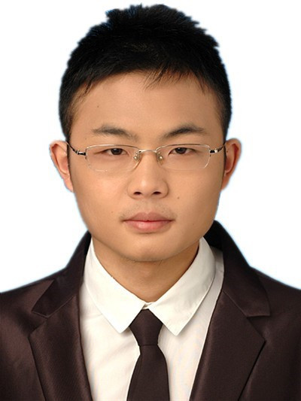


Our team
Guanjie Zheng, Fuzheng Zhang, Zihan Zheng, Yang Xiang, Nicholas Jing Yuan, Xing Xie, Zhenhui (Jessie) Li
Thanks!

